Slide 1
Game Engine Supporting Materials
Presenter: Myles Dalton
Advisor: Professor Kelvin Sung
CSS 497
6/10/2022

Slide 2
Overview
What I did
Create documentation and tutorial webpages for a 2D web game engine
Motivation
Make the engine API more accessible for new users
Significance
Help UW students learn in CSS 452

Slide 3
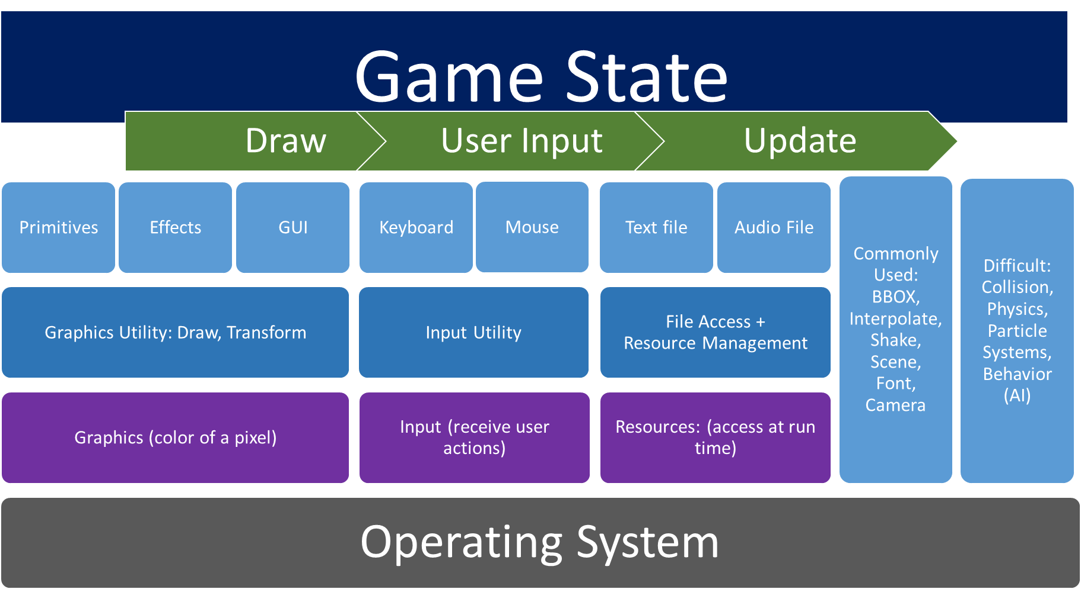
The Game Engine
Game engines provide implementation solutions for common game features

Slide 4
Need For Support
Complicated API spread across 73 different files
Many interrelated object types
Contains several non-trivial features
Does not have a graphic interface
Intended to be an educational tool for developers not experienced with game creation

Slide 5
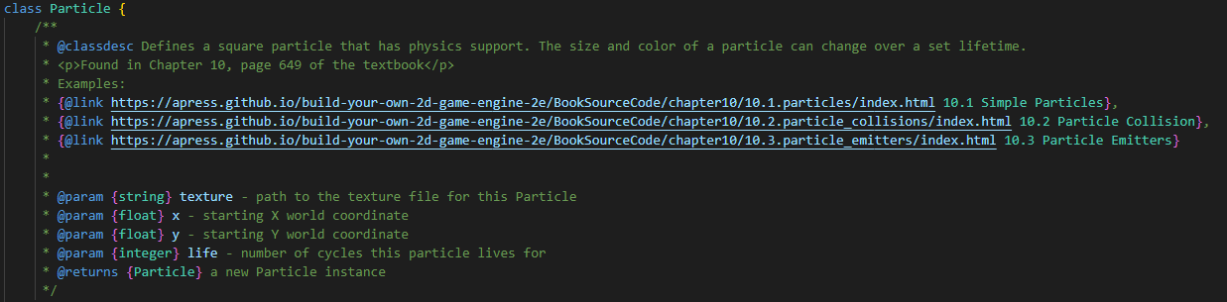
Writing documentation
Goals
Communicate what the functions do and parameters they need
Easy to navigate
Create documentation that I would want to use
Methods
Document all developer facing functions
Links to the other documentation pages
Links to running game examples

Slide 6

Generating Webpages
Used JSDoc 3 to generate “good looking” webpages from source code documentation
Valuable tool for easy navigation goal
Recognizes other class names for linking
Adds sidebar with links to all documentation pages
Consistent organization of information

Slide 7
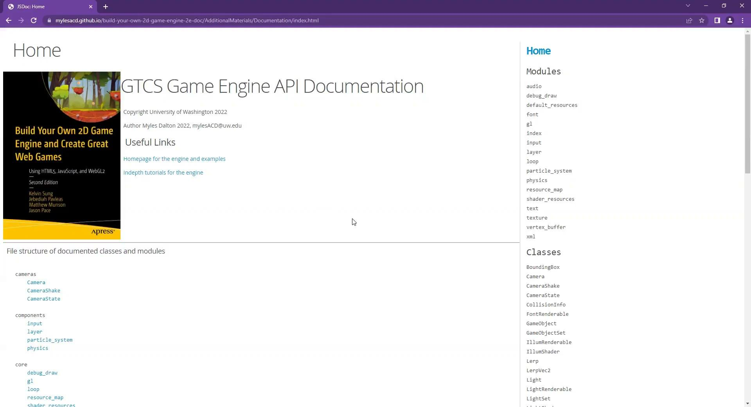
Documentation video

Slide 8
Tutorial Goals
Be useful and comprehensible for developers with no game engine experience
Cover the major features of the engine
Build in complexity slowly
Explain how and why to use the covered features

Slide 9
Tutorial Results
Seven tutorials that build upon one another
Setting up development environment
Logical structure of a game
Audio, font, images, and user input
Animation & pixel-perfect collision
Physics & particles
Scene lighting
Shadows & parallax
Rudimentary example games as output of each tutorial
Snippets of game code with explanation
Homepage or sequential navigation through tutorials

Slide 10
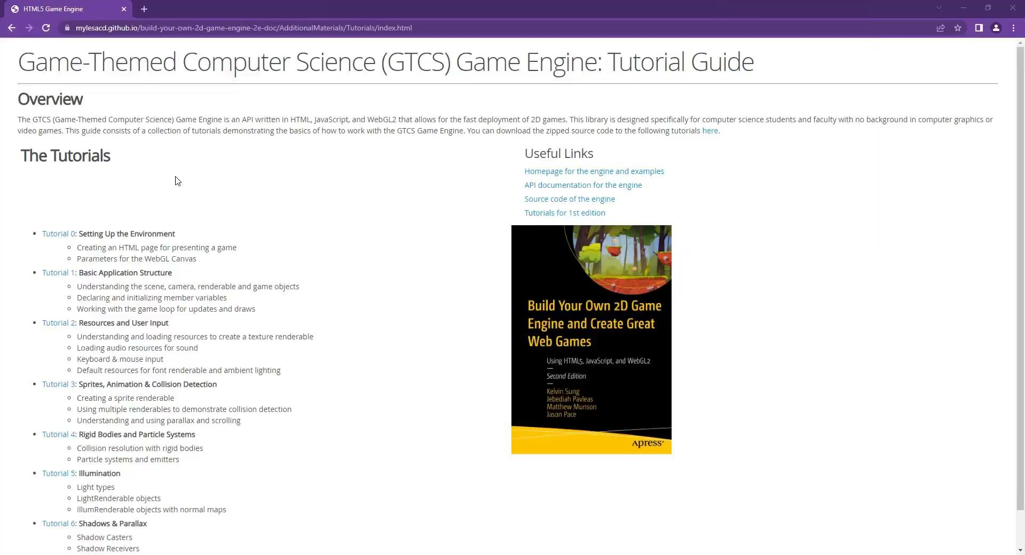
Tutorial Demonstration

Slide 11
Conclusion
Project outcomes
Comprehensive, beginner focused tutorials
Quality online documentation
Experience with javascript and HTML
Experience learning a complicated API
Future work: tutorial for minor features and more interlinking of tutorials to documentation

Slide 12
Questions?

